Slide 1

TENSORFLOW 2.0
PRACTICAL ADVANCED

Slide 2

RECURRENT NEURAL NETWORKS INTUITION

Slide 3
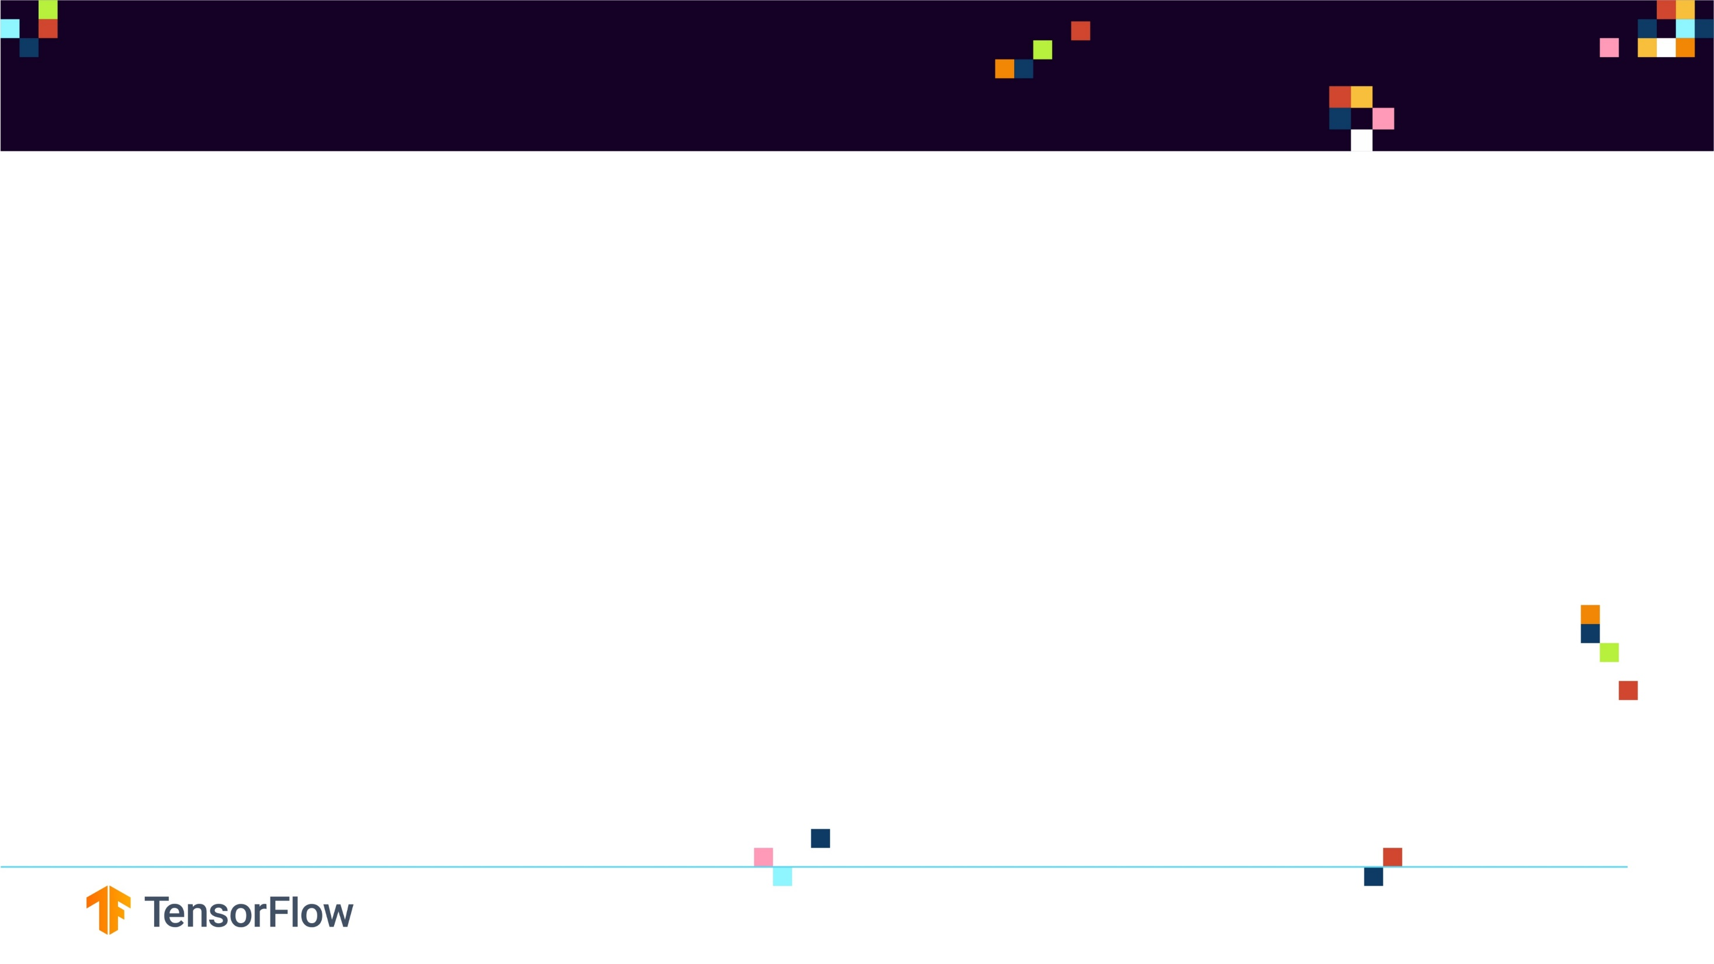
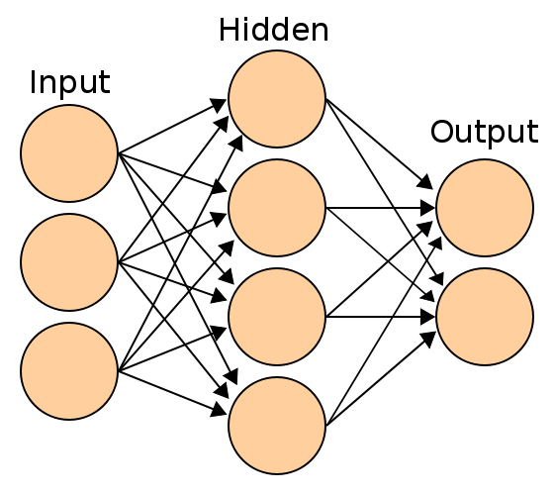
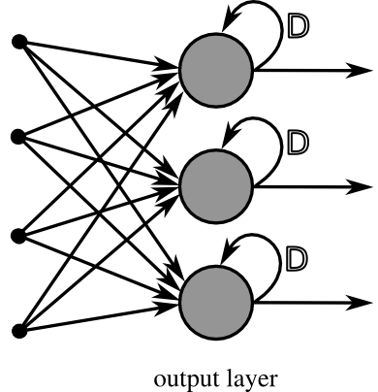
RECURRENT NEURAL NETWORKS (RNN): WHAT ARE THEY?
We covered Feedforward Neural Networks (vanilla networks) that map a fixed size input (such as image) to a fixed size output (classes or probabilities).
A drawback in Feedforward networks is that they do not have any time dependency or memory effect.
A RNN is a type of ANN that is designed to take temporal dimension into consideration by having a memory (internal state) (feedback loop).
FEED FORWARD ANN
RECURRENT NEURAL NETWORK
Photo Credit: https://commons.wikimedia.org/wiki/File:RecurrentLayerNeuralNetwork_english.png
Photo Credit: https://commons.wikimedia.org/wiki/File:Artificial_neural_network.svg

Slide 4
RECURRENT NEURAL NETWORKS ARCHITECTURE

Slide 5
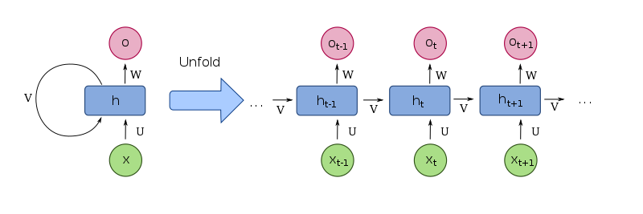
RNN ARCHITECTURE
A RNN contains a temporal loop in which the hidden layer not only gives an output but it feeds itself as well.
An extra dimension is added which is time!
RNN can recall what happened in the previous time stamp so it works great with sequence of text.
TIME
Photo Credit: https://fr.wikipedia.org/wiki/Fichier:Recurrent_neural_network_unfold.svg

Slide 6
RNNs WORK LIKE MAGIC!
We’ll train RNNs to generate text character by character and ponder the question “how is that even possible?”
Source: The Unreasonable Effectiveness of Recurrent Neural Networks by Andrej Karpathy
http://karpathy.github.io/2015/05/21/rnn-effectiveness/

Slide 7
WHAT MAKES RECURRENT NEURAL NETWORKS SO SPECIAL?!

Slide 8
WHAT MAKES RNNs SO SPECIAL?
Feedforward ANNs are so constrained with their fixed number of input and outputs.
For example, a CNN will have fixed size image (28x28) and generates a fixed output (class or probabilities).
Feedforward ANN have a fixed configuration, i.e.: same number of hidden layers and weights.
Recurrent Neural Networks offer huge advantage over feedforward ANN and they are much more fun!
RNN allow us to work with a sequence of vectors:
Sequence in inputs
Sequence in outputs
Sequence in both!
RECURRENT NEURAL NETWORK
Source: The Unreasonable Effectiveness of Recurrent Neural Networks by Andrej Karpathy
http://karpathy.github.io/2015/05/21/rnn-effectiveness/
Photo Credit: https://commons.wikimedia.org/wiki/File:RecurrentLayerNeuralNetwork_english.png

Slide 9


WHAT MAKES RNNs SO SPECIAL?
OUTPUT: CAT
OUTPUT:
CUTE GRAY AND WHITE CAT
ONE TO ONE (VANILLA)
APPLICATION: REGRESSION AND CLASSIFICATION
ONE TO MANY (SEQUENCE OUTPUT)
APPLICATION: IMAGE CAPTIONING, INPUT = IMAGE
OUTPUTS = SENTENCE OF WORDS)
OUTPUT: 1
INPUT: I AM REALLY ENJOYING THIS COURSE!
MANY TO ONE (SEQUENCE INPUT)
APPLICATION: SENTIMENT ANALYSIS,
EX: IS A REVIEW POSITIVE OR NEGATIVE?
MANY TO MANY (SEQUENCE INPUT AND OUTPUT)
APPLICATION: LANGUAGE TRANSLATION,
Photo Credit: https://fr.wikipedia.org/wiki/Fichier:Recurrent_neural_network_unfold.svg

Slide 10
RECURRENT NEURAL NETWORK MATH

Slide 11
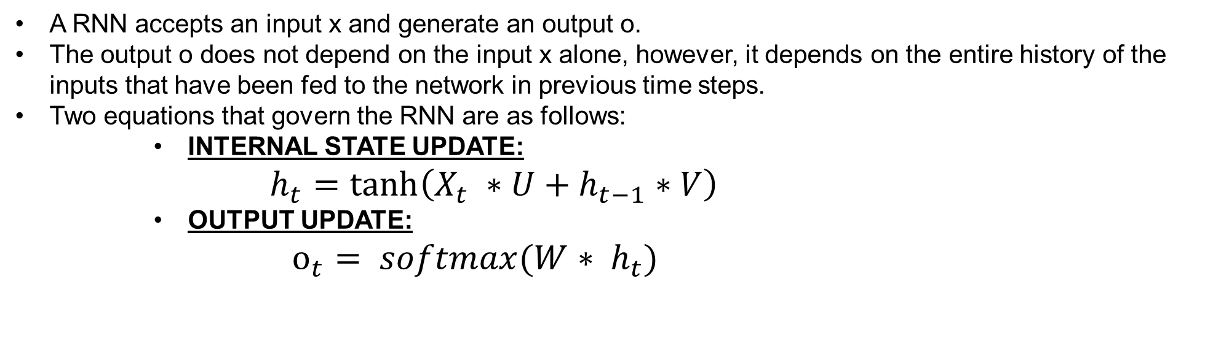
RNN MATH
A RNN accepts an input x and generate an output o.
The output o does not depend on the input x alone, however, it depends on the entire history of the inputs that have been fed to the network in previous time steps.
Two equations that govern the RNN are as follows:
INTERNAL STATE UPDATE:
$$h_{t}=\tanh\left(X_{t} ∗U+h_{t−1}∗V\right)$$
OUTPUT UPDATE:
$o_{t}= softmax({W∗ h}_{t})$
Photo Credit: https://fr.wikipedia.org/wiki/Fichier:Recurrent_neural_network_unfold.svg

Slide 12
LET’S HAVE SOME FUN WITH RECURRENT NEURAL NETWORKS! ☺

Slide 13
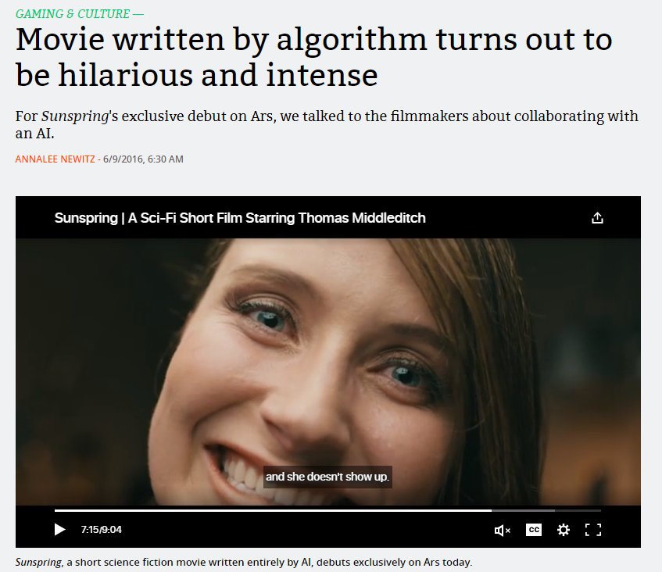
LET’S WATCH THIS MOVIE WRITTEN BY AN RNN!
Let’s watch a movie written by AI!
https://arstechnica.com/gaming/2016/06/an-ai-wrote-this-movie-and-its-strangely-moving/
The movie was written by an LSTM recurrent neural network
The LSTM network was trained with a corpus of dozens of sci-fi screenplays from movies from the 1980s and 90s.
Photo Credit: https://fr.wikipedia.org/wiki/Fichier:Recurrent_neural_network_unfold.svg

Slide 14
VANISHING GRADIENT PROBLEM

Slide 15
VANISHING GRADIENT PROBLEM
LSTM networks work much better compared to vanilla RNN since they overcome the vanishing gradient problem.
The error has to propagate through all the previous layers resulting in a vanishing gradient.
As the gradient goes smaller, the network weights are no longer updated.
As more layers are added, the gradients of the loss function approaches zero, making the network hard to train.
EACH LAYER DEPENDS ON THE OUTPUT FROM THE PREVIOUS LAYERS, THE “V” IS MULTIPLIED SEVERAL TIMES RESULTING IN VANISHING GRADIENT
0.1 * 0.1 * 0.1 *…..*0.1 =1e-10
Photo Credit: https://fr.wikipedia.org/wiki/Fichier:Recurrent_neural_network_unfold.svg

Slide 16
VANISHING GRADIENT PROBLEM
ANN gradients are calculated during backpropagation.
In backpropagation, we calculate the derivatives of the network by moving from the outermost layer (close to output) back to the initial layers (close to inputs).
The chain rule is used during this calculation in which the derivatives from the final layers are multiplied by the derivatives from early layers.
The gradients keeps diminishing exponentially and therefore the weights and biases are no longer being updated.
EACH LAYER DEPENDS ON THE OUTPUT FROM THE PREVIOUS LAYERS, THE “V” IS MULTIPLIED SEVERAL TIMES RESULTING IN VANISHING GRADIENT, (ex: 0.1 * 0.1 * 0.1 *…..*0.1 =1e-10)
New Weight = Old Weight – Learning rate * gradient
9.09999 = 10.1 – 1 * 0.001
Photo Credit: https://fr.wikipedia.org/wiki/Fichier:Recurrent_neural_network_unfold.svg

Slide 17
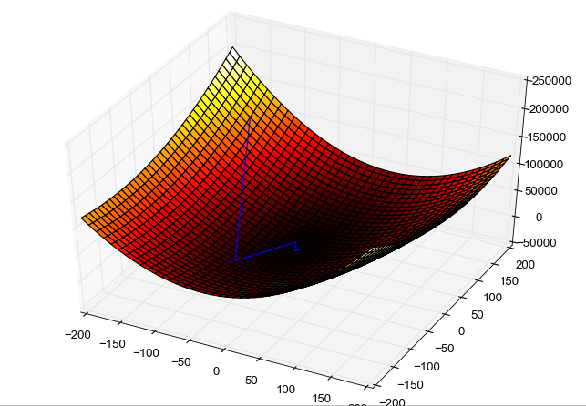
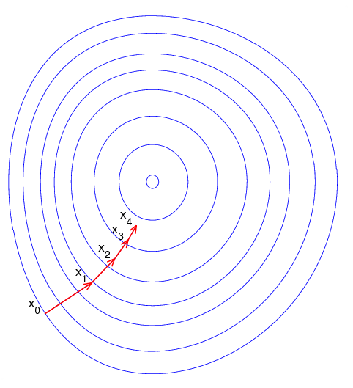
GRADIENT DESCENT
Gradient descent is an optimization algorithm used to obtain the optimized network weight and bias values
It works by iteratively trying to minimize the cost function
It works by calculating the gradient of the cost function and moving in the negative direction until the local/global minimum is achieved
If the positive of the gradient is taken, local/global maximum is achieved
Photo Credit: https://commons.wikimedia.org/wiki/File:Gradient_descent_method.png
Photo Credit: https://commons.wikimedia.org/wiki/File:Gradient_descent.png

Slide 18
LEARNING RATE
The size of the steps taken are called the learning rate
If learning rate increases, the area covered in the search space will increase so we might reach global minimum faster
However, we can overshoot the target
For small learning rates, training will take much longer to reach optimized weight values

Slide 19


GRADIENT DESCENT
Gradient descent works as follows:
Calculate the derivative (gradient) of the Loss function
Pick random values for parameters m, b and substitute
Calculate the step size (how much are we going to update the parameters?)
$Step size = Slope ∗ learning rate$
4. Update the parameters and repeat
OPTIMAL POINT
GLOBAL MINIMUM
Sum of Squared Residuals
$$y=b+m∗x$$
GOAL IS TO FIND
BEST PARAMETERS
*Note: in reality, this graph is 3D and has three axes, one for m, b and sum of squared residuals
Parameters (m, b)

Slide 20

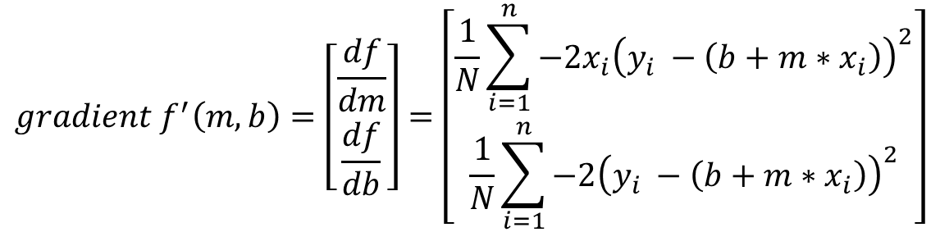
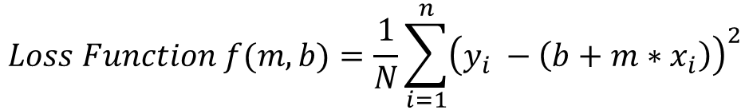
GRADIENT DESCENT MATH!
$$y=b+m∗x$$
GOAL IS TO FIND
BEST PARAMETERS
$$Loss Function f(m,b)=\frac{1}{N}\sum_{i=1}^{n}{{\left(y_{i} −\left(b+m∗x_{i}\right)\right)}^{2}}$$
OPTIMAL POINT
GLOBAL MINIMUM
$$gradient f^{′}\left(m,b\right)=\left[\begin{matrix}\frac{df}{dm} \\ \frac{df}{db}\end{matrix}\right]=\left[\begin{matrix}\frac{1}{N}\sum_{i=1}^{n}{−2x_{i}{\left(y_{i} −\left(b+m∗x_{i}\right)\right)}^{2}} \\ \frac{1}{N}\sum_{i=1}^{n}{−2{\left(y_{i} −\left(b+m∗x_{i}\right)\right)}^{2}}\end{matrix}\right]$$
Sum of Squared Residuals (Loss Function)
Parameters (m, b)
*Note: in reality, this graph is 3D and has three axes, one for m, b and sum of squared residuals

Slide 21
LONG SHORT TERM MEMORY (LSTM) NETWORKS

Slide 22

































LSTM INTUITION
LSTM networks work better compared to vanilla RNN since they overcome vanishing gradient problem.
In practice, RNN fail to establish long term dependencies.
Reference: https://colah.github.io/posts/2015-08-Understanding-LSTMs/
I live in Quebec in Northern Canada……where I live, the weather is generally “cold” most of the year
The tree color is “green”
$$h_{0}$$
$$h_{1}$$
$$h_{2}$$
$$h_{3}$$
$$h_{0}$$
$$h_{1}$$
$$h_{2}$$
$$h_{3}$$
$$h_{t}$$
$$h_{t+1}$$
$$h_{t+2}$$
$$A$$
$$A$$
$$A$$
$$A$$
$$A$$
$$A$$
$$A$$
$$A$$
$$A$$
$$A$$
$$A$$
$$x_{0}$$
$$x_{1}$$
$$x_{2}$$
$$x_{3}$$
$$x_{0}$$
$$x_{1}$$
$$x_{2}$$
$$x_{3}$$
$$x_{t}$$
$$x_{t+1}$$
$$x_{t+2}$$
RNN PERFORMS WELL SINCE THE GAP BETWEEN THE PREDICTION “GREEN” AND THE NECESSARY CONTEXT INFORMATION “TREE” IS SMALL
RNN PERFORMS POORLY WHEN THE GAP BETWEEN THE PREDICTION “COLD” AND THE NECESSARY CONTEXT INFORMATION “CANADA” IS LARGE
Reference: https://colah.github.io/posts/2015-08-Understanding-LSTMs/

Slide 23
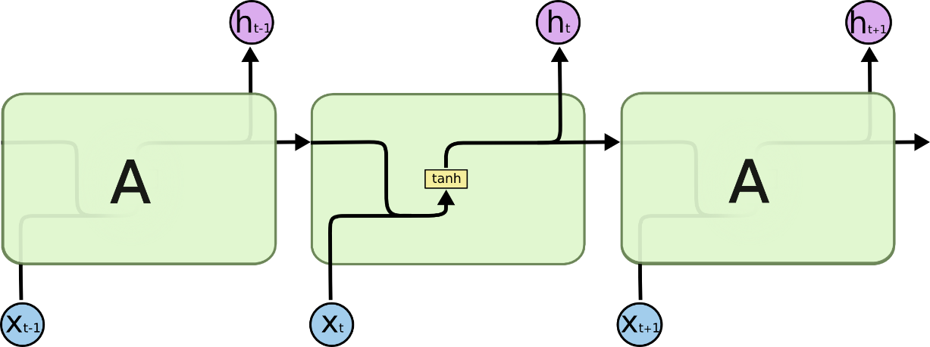

LSTM INTUITION
LSTM networks are type of RNN that are designed to remember long term dependencies by default.
LSTM can remember and recall information for a prolonged period of time.
Recall that each line represents a full vector.
THIS HORIZONTAL LINE (MEMORY) OR CELL STATE ENABLES LSTM TO REMEMBER VERY OLD INFORMTION
VANILLA RECURRENT NEURAL NETWORK
LONG SHORT TERM MEMORY NETWORK
Reference and Photo Credit: https://colah.github.io/posts/2015-08-Understanding-LSTMs/

Slide 24
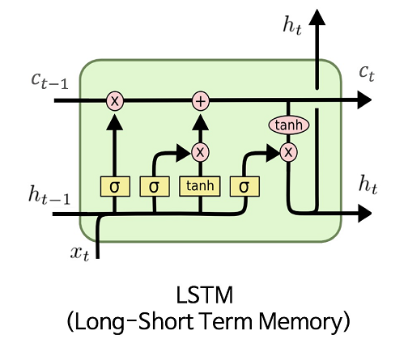
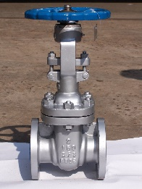
LSTM INTUITION – GATES
LSTM contains gates that can allow or block information from passing by.
Gates consist of a sigmoid neural net layer along with a pointwise multiplication operation.
Sigmoid output ranges from 0 to 1:
0 = Don’t allow any data to flow
1 = Allow everything to flow!
INPUT GATE
FORGET GATE
OUTPUT GATE
Reference and Photo Credit: https://colah.github.io/posts/2015-08-Understanding-LSTMs/
Photo Credit: https://commons.wikimedia.org/wiki/File:LSTM.png

Slide 25








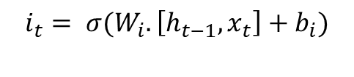

LSTM INTUITION – MATH
$f_{t}= σ(W_{f}.\left[h_{t−1}, x_{t}\right]+b_{f}$)
$$i_{t}= σ(W_{i}.\left[h_{t−1}, x_{t}\right]+b_{i})$$
$$C_{t}=f_{t}∗C_{t−1}+i_{t}∗{\tilde{C}}_{t}$$
$$i_{t}$$
$$o_{t}$$
$$f_{t}$$
$${\tilde{C}}_{t}$$
$${\tilde{C}}_{t}=tanh⁡(W_{c}.\left[h_{t−1}, x_{t}\right]+b_{c}$$
$$o_{t}=σ(W_{o}.\left[h_{t−1}, x_{t}\right]+b_{o})$$
$$h_{t}=o_{t}∗tanh⁡(C_{t})$$
Reference and Photo Credit: https://colah.github.io/posts/2015-08-Understanding-LSTMs/

